Slide 1
Stroke risk and patients health analytics dashboard
data model . Calculated columns . Dax measures . Page layout

Slide 2
OBJECTIVE
Why this dashboard exists and what it needs to answer
CATALOG SNAPSHOT
5110
Total patients
249
Stroke cases
12
Column used
4.87%
Observed stroke rate
Give a single, trusted view of patient demographics and clinical indicators.
Show which segments - by age, hypertension, heart disease, glucose level, BMI, and smoking - have higher stroke incidence in this data.
Let users filter and drill down by demographic and lifestyle attributes without needing technical skills.
Be transparent about data quality (missing BMI, unknown smoking status) instead of hiding gaps.
Build the data model in a way that can be refreshed or extended with future data.

Slide 3
From row data to dashboard
The build sequence this deck follows
12
Source columns
Id, Gender, Age,Hypertension,Heart-disease,Ever-married,Work type,Residence type,Avg-glucose-level,BMI,Smoking-status,Sroke
6
Calculated columns
Age-group,Bmi category,Glucose category,Hypertension status,Heart-disease status,Stroke status
9
DAX Measures
Total patients, Stroke rate , averages,Number of cases
4
Dashboard pages
Overview,Clinical risk factors,Demographical and lifestyle,Keyinsights

Slide 4
DAX measures
Measure | DAX
Total Patients | Total Patients = COUNTROWS(Stroke _cleaned_ data )
Stroke Cases | Stroke Cases = CALCULATE(COUNTROWS(Stroke _cleaned_ data ), Stroke _cleaned_ data [stroke] = 1)
Non-Stroke Cases | Non-Stroke Cases = CALCULATE(COUNTROWS(Stroke _cleaned_ data ), Stroke _cleaned_ data [stroke] = 0)
Stroke Rate | Stroke Rate = DIVIDE([Stroke Cases], [Total Patients], 0)
Average Age | Average Age = AVERAGE(Stroke _cleaned_ data [age])
Average Glucose | Average Glucose = AVERAGE(Stroke _cleaned_ data [avg _glucose _ level])
Average BMI | Average BMI = AVERAGE(Stroke _cleaned_ data [ Bmi ])
Hypertension Cases | Hypertension Cases = CALCULATE(COUNTROWS(Stroke _cleaned_ data ), Stroke _cleaned_ data [hypertension] = 1)
Heart Disease Cases | Heart Disease Cases = CALCULATE(COUNTROWS(Stroke _cleaned_ data ), Stroke _cleaned_ data [heart_ disease] = 1)

Slide 5
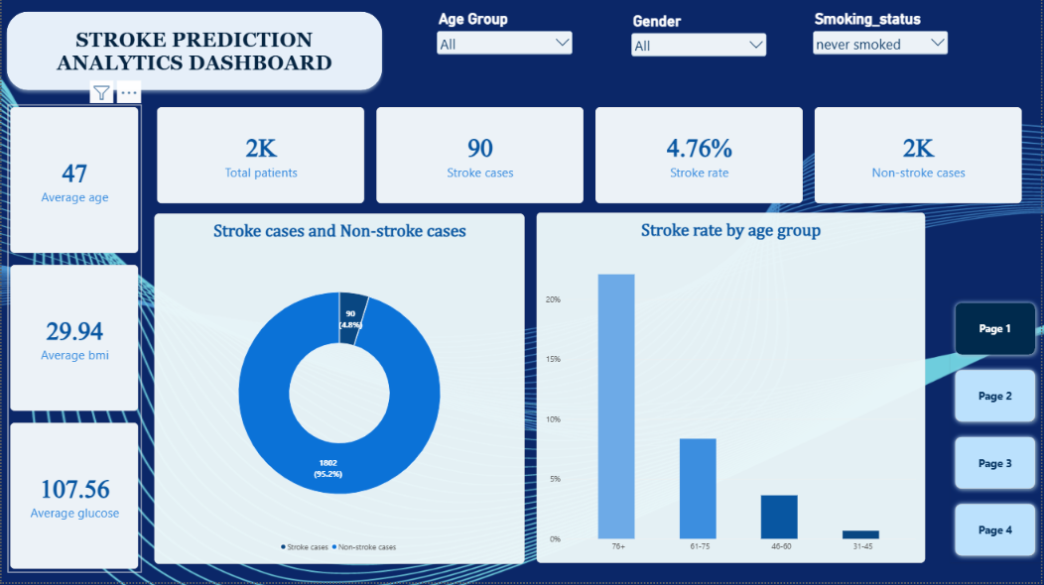

Slide 6
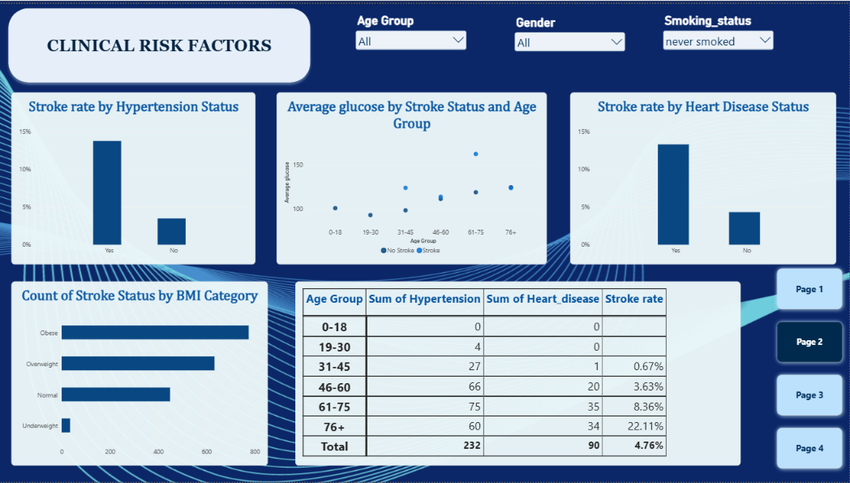

Slide 7
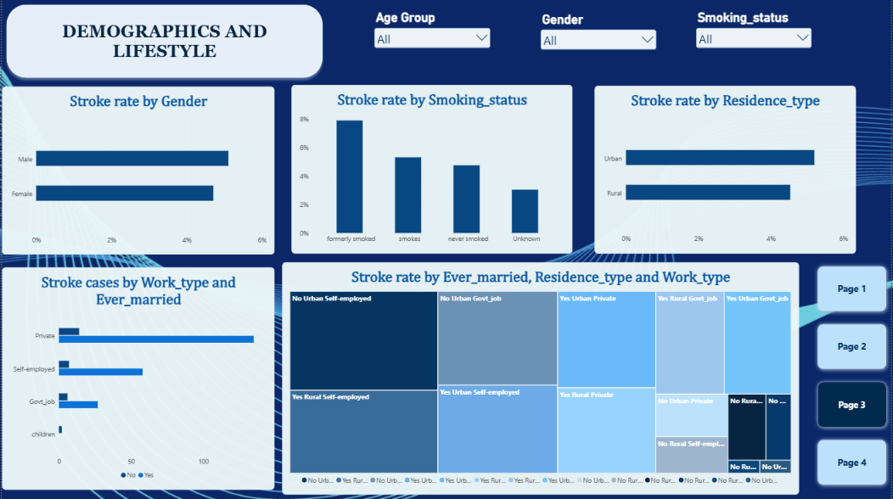

Slide 8
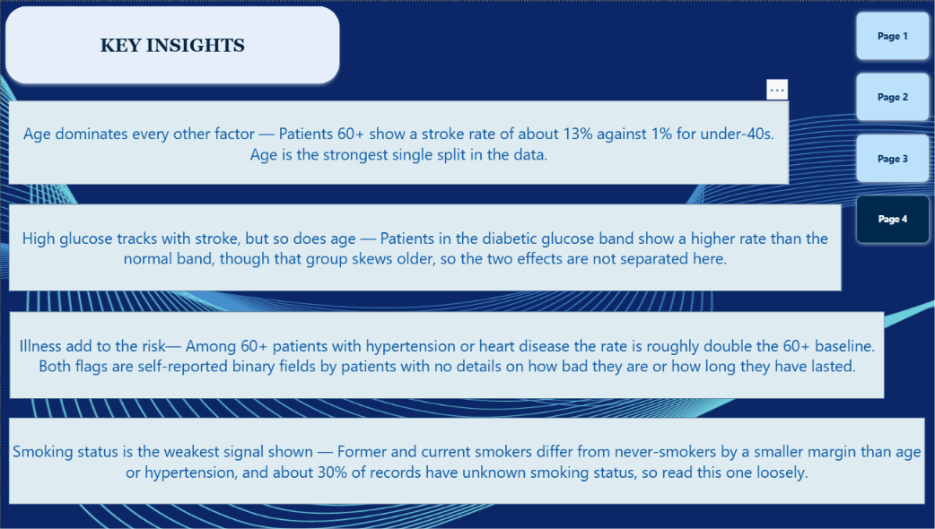

Slide 9
BUILD ORDER
1
First download stroke prediction table data into excel ,and clean the data with the help of power query editor
2
Import stroke prediction excel file into power bi and conform data types
3
Build the 7 Dax measures from the dataset
4
Build report pages in the order : overview ,clinical risk factors ,demographic and lifestyle, key insight
5
Add age-group, gender , smoking status slicers on every pages for cross-filtering
6
Add page navigators in every pages

